Slide 1

Name : Aviel Danin

Slide 2


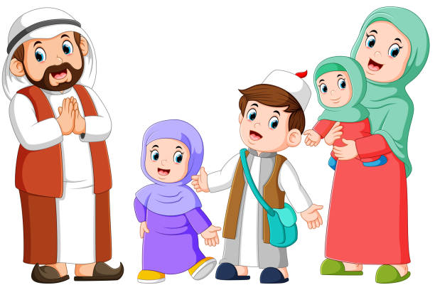

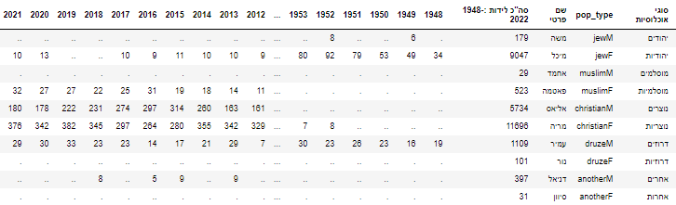

Slide 3
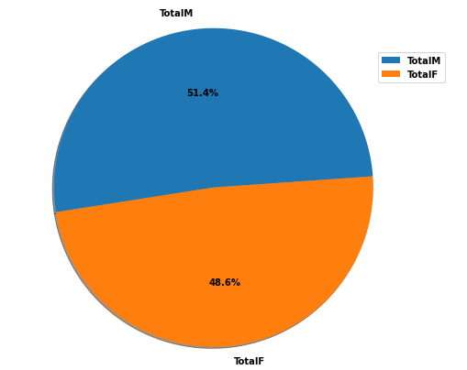
Total births
ratio = TotalF / TotalM
48.6 / 51.4 = 0.945
M – male
F – female
Now it can be assumed that every person will be able to find a partner .
Let's see the division for the entire population .

Slide 4
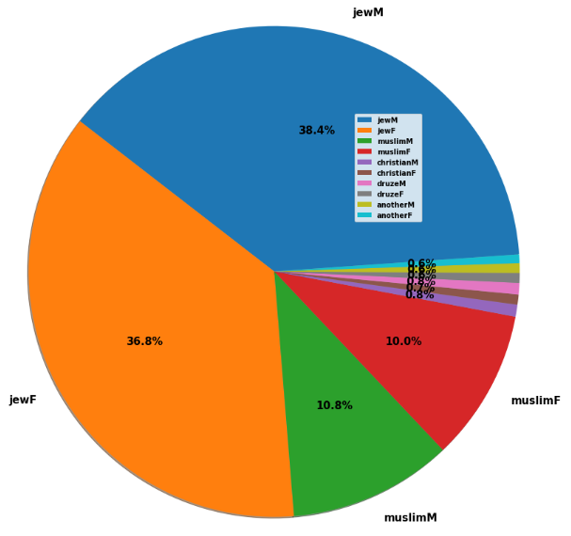

The distribution of the population
The Jewish and Muslim sectors , make up about 96% of society.
And therefore we would like to delve more deeply into them.

Slide 5
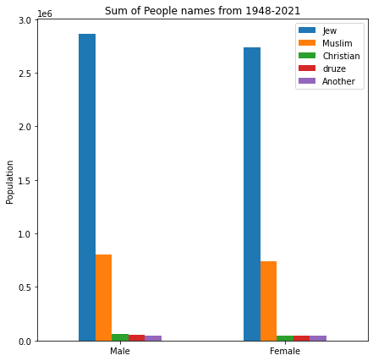
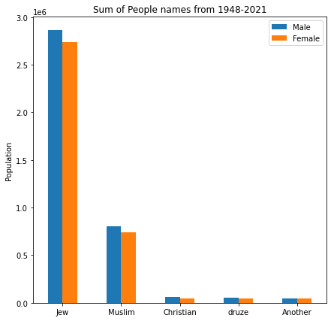
Before the treasure , let’s see two more forms of presentation

Slide 6
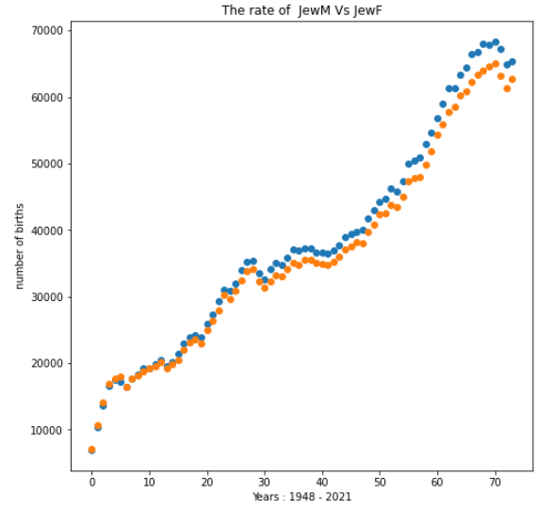
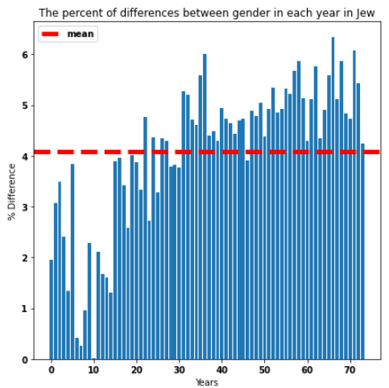

The two graphs of JewM and JewF are very similar.
Therefore, we can strengthen the claim we saw in the first pie , by saying that the ratio between the sexes remains almost always the same every year.
In addition, the average difference percentage is: 4.09 , which means that the situation in Jewish society is better than the other populations.

Slide 7
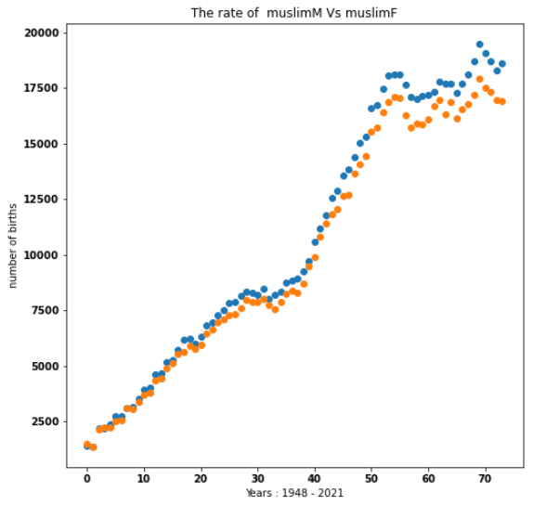
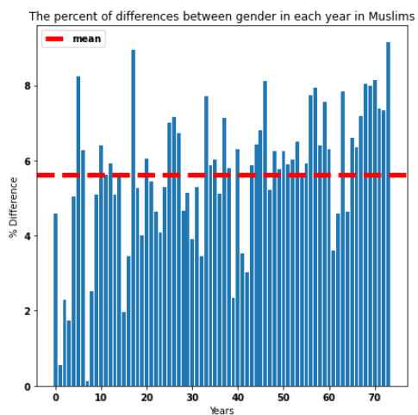
As we saw earlier in Jewish society, the situation is similar in Arab society, only the gap in percentages between the sexes is greater, and the total number of births is 3.5 times smaller than in Jewish society.
Now we will examine the changes in the rate of births

Slide 8
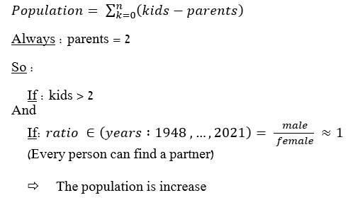
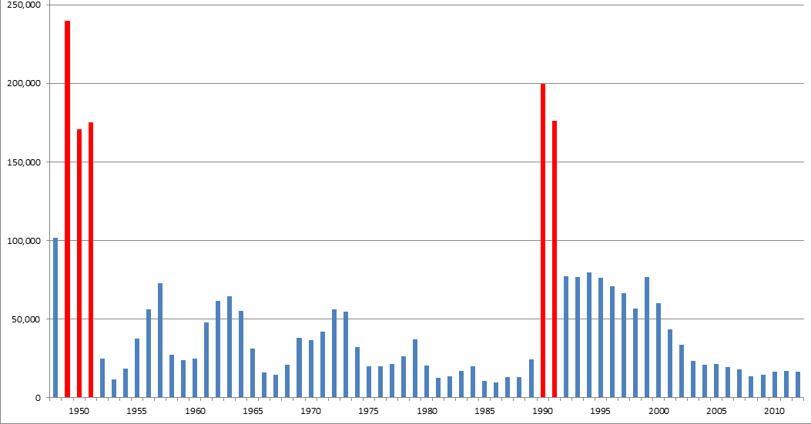
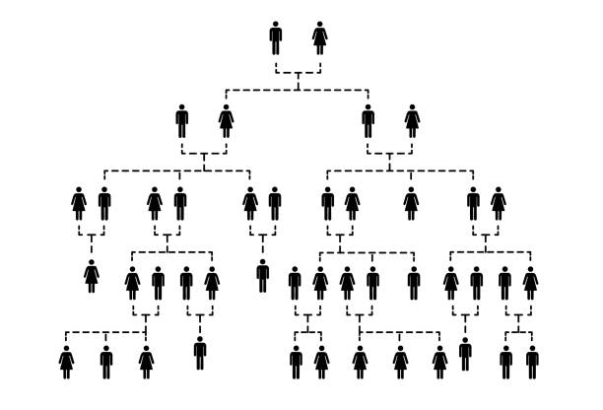
Jewish immigration to Israel by years
It is not possible to know the fertility rate because we do not know the number of births.
According to data from the Internet, the fertility rate in Jewish and Arab society is always above 2.5.
In my opinion, we will see an exponential increase in the number of births
&

Slide 9
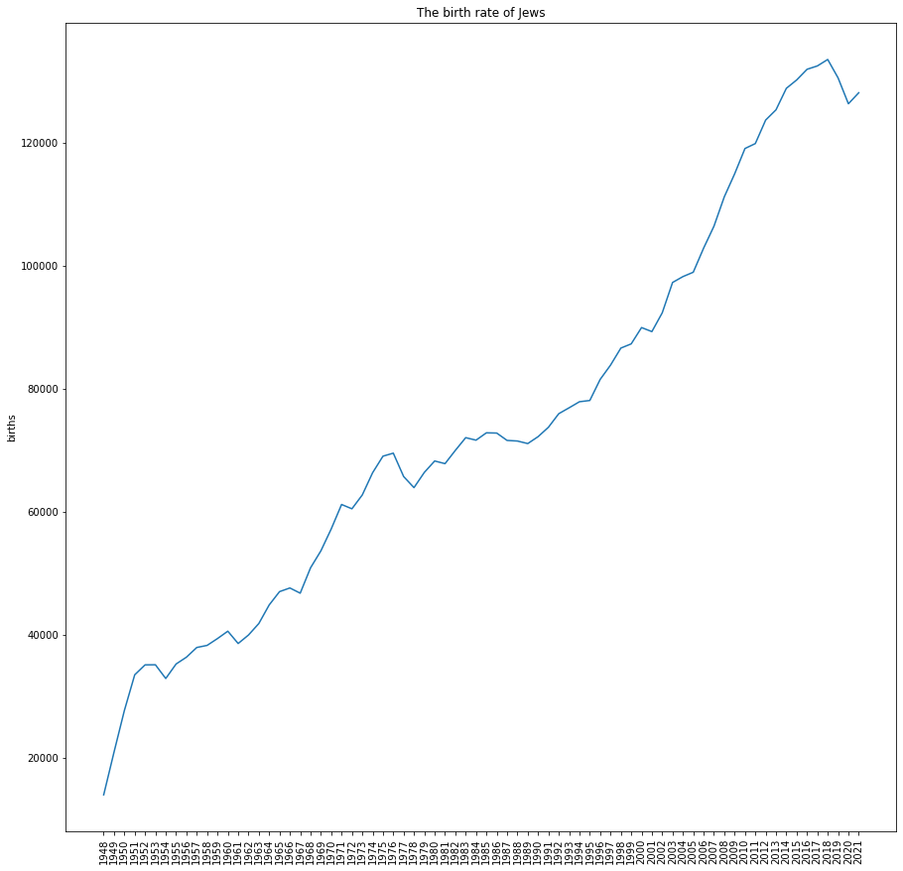
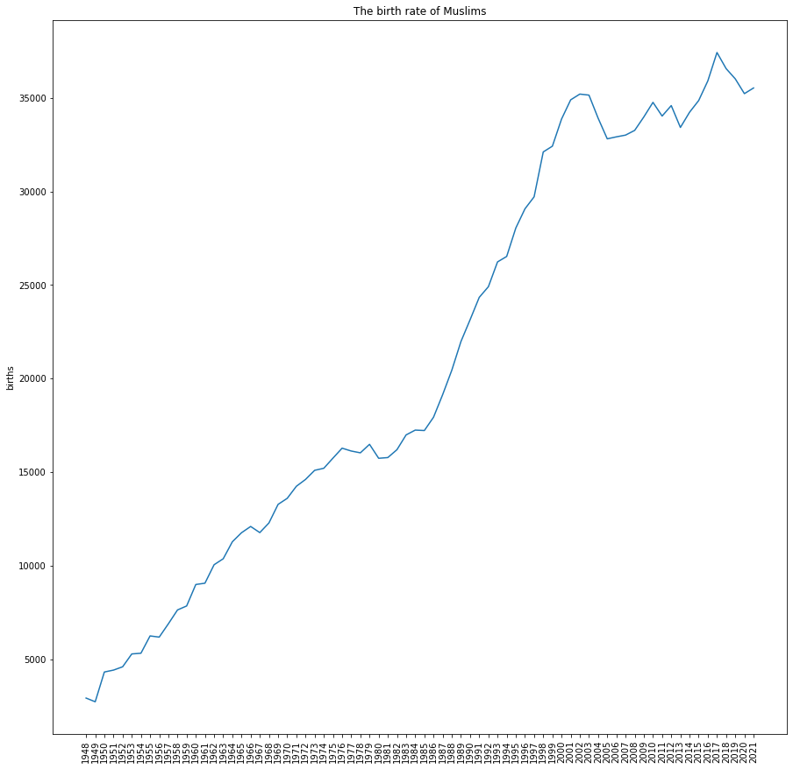
C
B
3 Parts :
A :
The largest immigration since the founding of the state.
B :
As I said before, growth in an exponential manner due to the fertility rate in addition to the amount of immigrants who came every year and immigration from Russia in 1991.
C :
The Covid-9 epidemic
A
B
2 Parts :
A :
Growth in an exponential manner due to the fertility rate
B :
Saw shape.
Perhaps due to the integration of Arabs into Israeli society in the early 2000s, some of them began to live a more "western" lifestyle, which mainly encourages a smaller number of children. In addition, the age of marriage is increasing, which can explain the teeth of the saw.
The graph goes down because those potential parents don't have a child right now, but it goes up in the future because they ended up having a child just a few years later, and so on again.
A

Slide 10
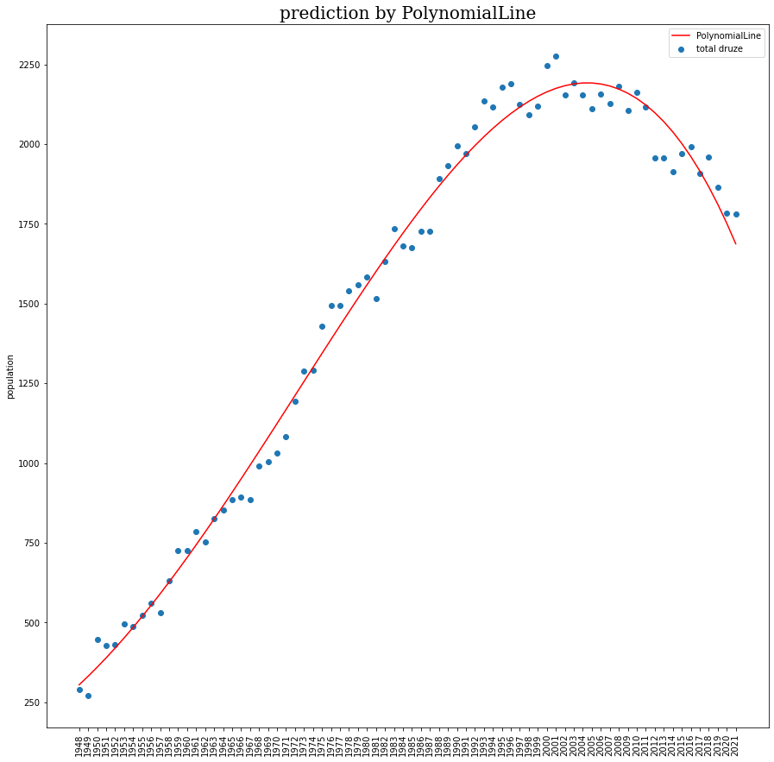
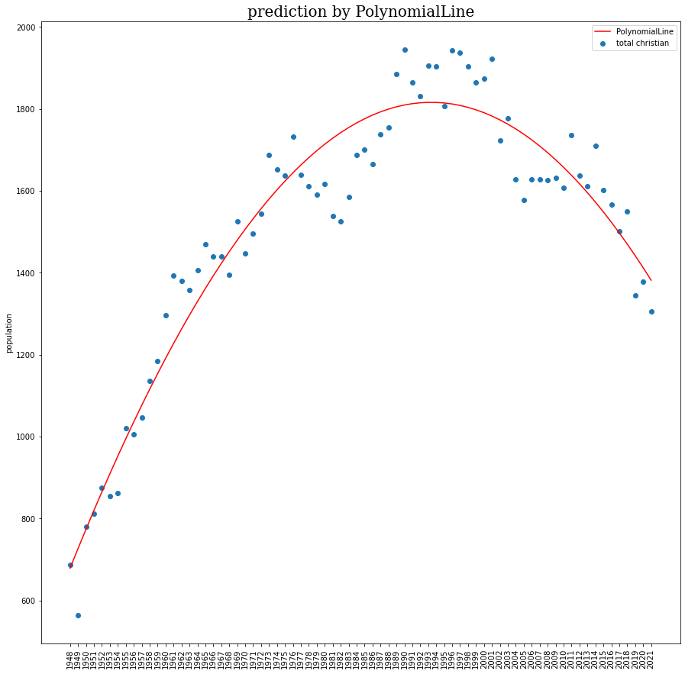
The depletion of these sectors due to a sharp decrease in the number of babies

Slide 11
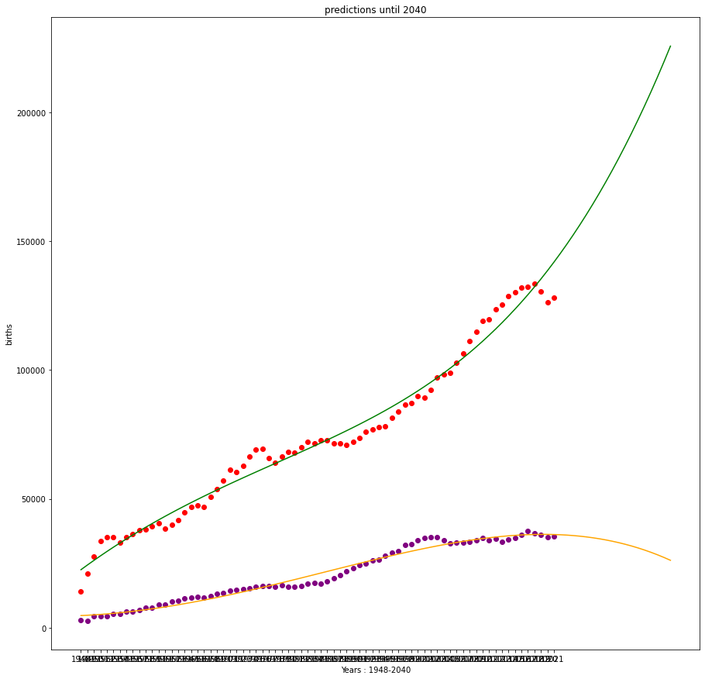
The Jewish majority in the State of Israel remains stable

Slide 12
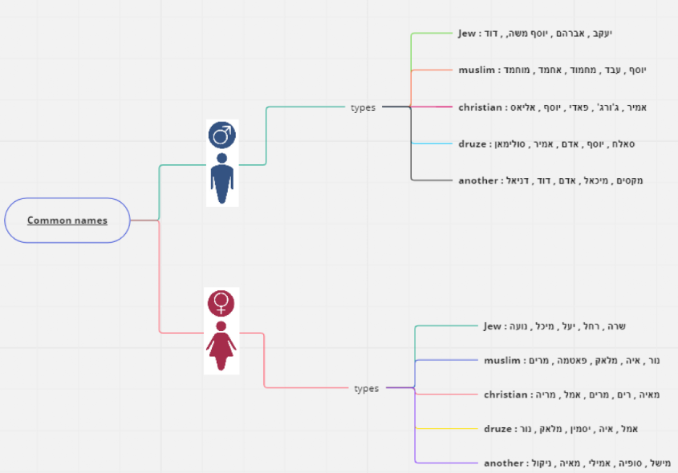
The most popular names among Jews, Muslims, Christians, and Druze are based on religion.
possible reasons :
Religious people have more children.
2. The people in every society name their children according to history, culture.

Slide 13
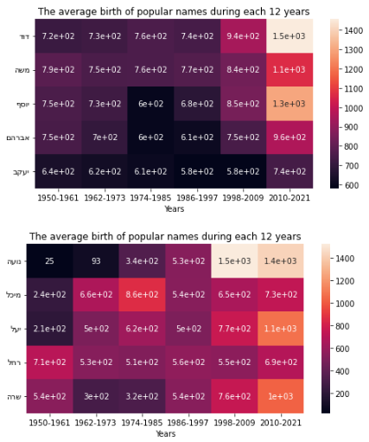
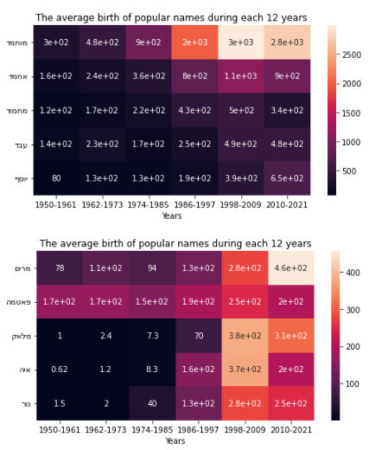
Most popular names are always on the rise

Slide 14
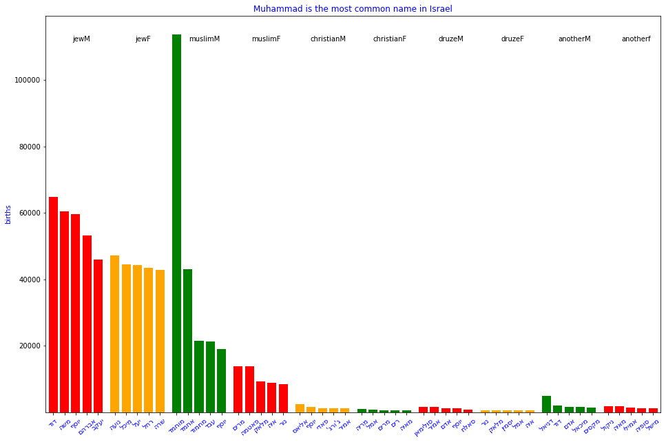
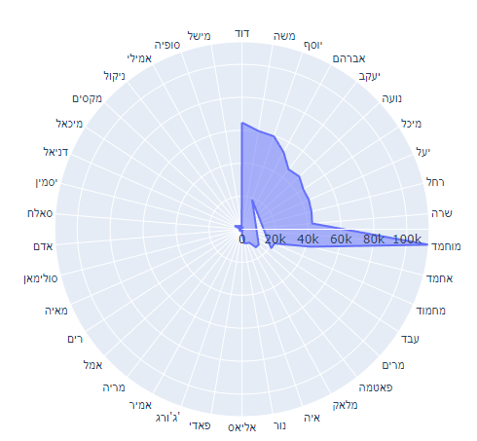
Most common name in IL

Slide 15
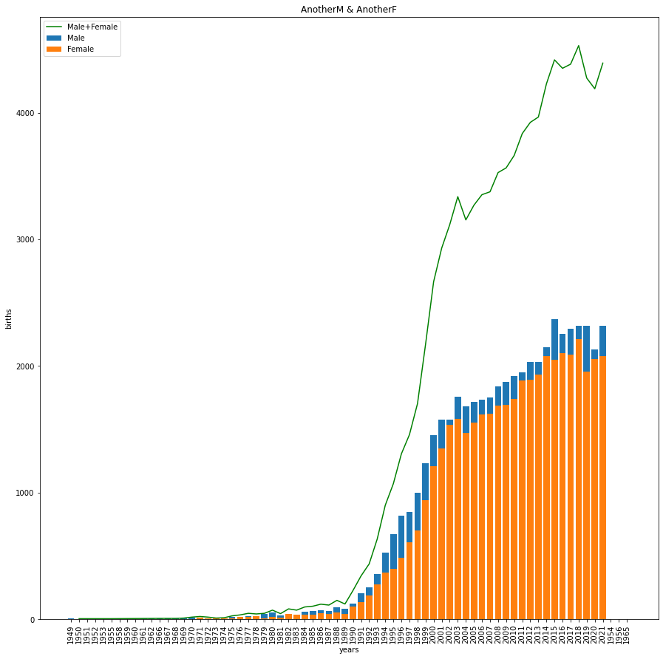
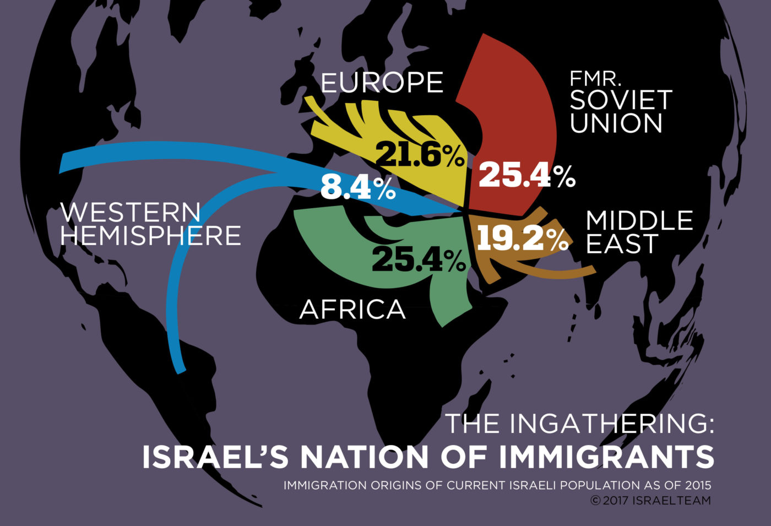
Israeli society is more diverse

Slide 16
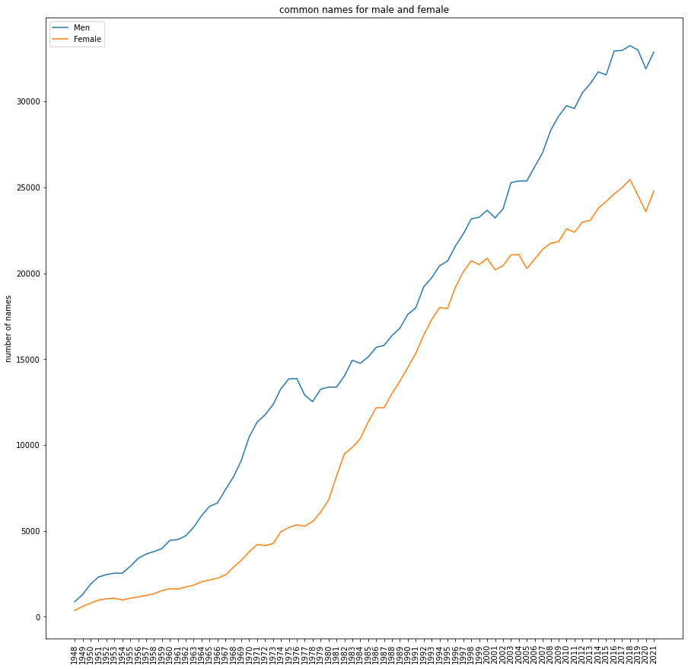
Names that are considered bisexual are still stronger over the years for men

Slide 17
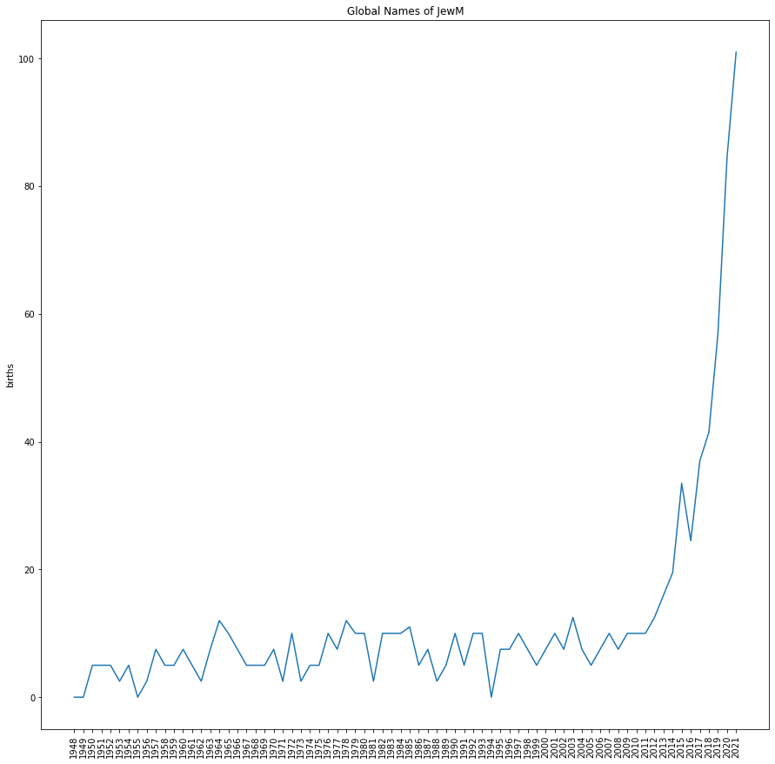
Rise of globalist names due to globalization

Slide 18


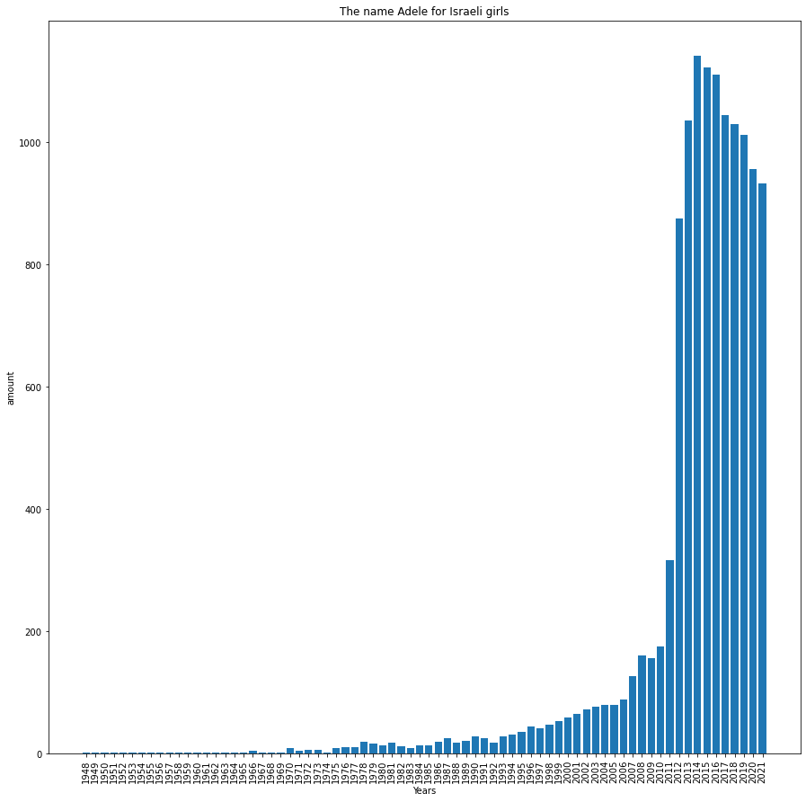
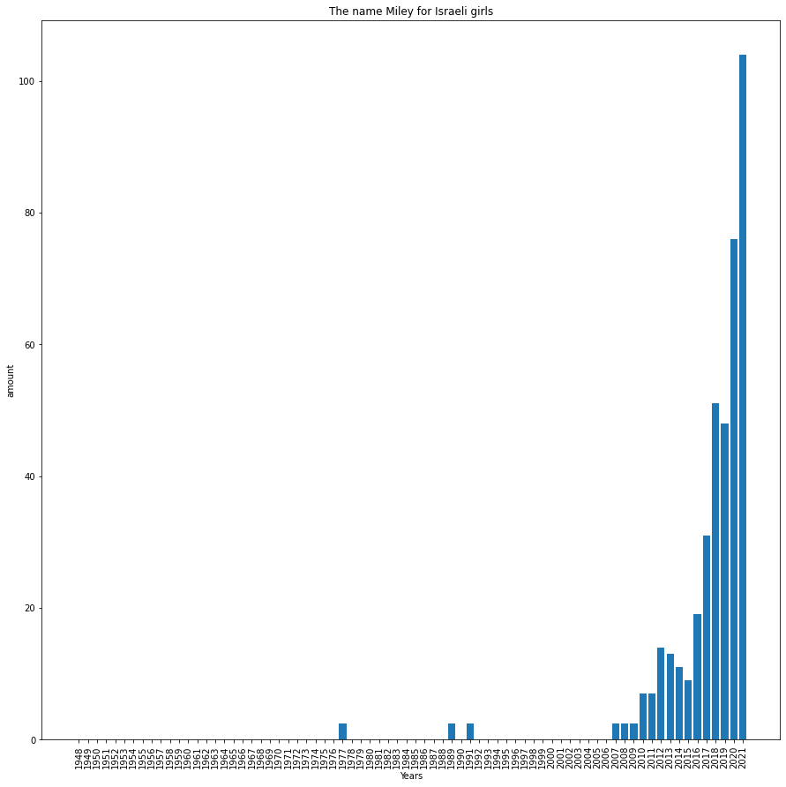
The influence of culture on names
Adele broke into consciousness in 2009
Miley broke into consciousness in 2007

Slide 19


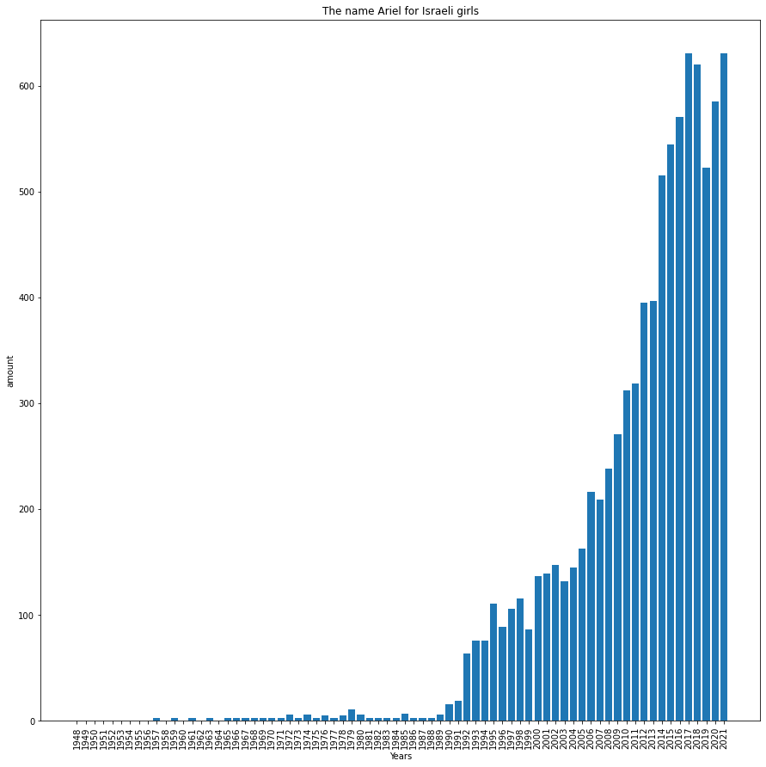
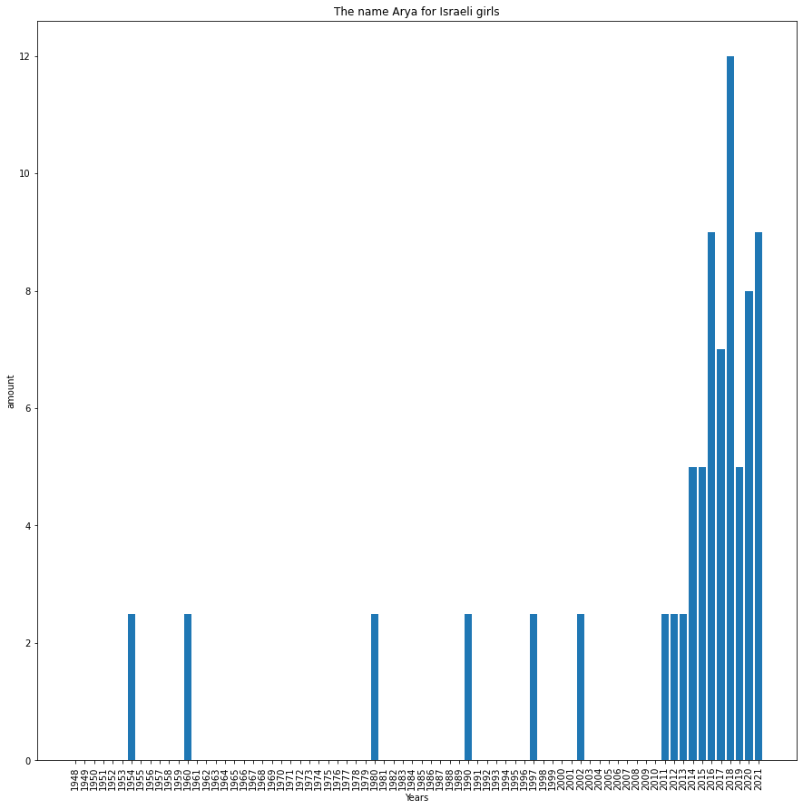
1989
2011

